Slide 1


TELECOM
CUSTOMER CHURN

Slide 2




Today's agenda
Case Study
Objective
Process
Insights
Summary

Slide 3


Case Study
Notes:
This case study has 2 data sets.
The first data sets consists of information about customer churn rate

Slide 4





OBJECTIVE
Maximize: Company’s profit by retaining customer.
Minimize: Customer churn rate by identifying the key cause of the problem.
Business Constraint: Provide offers and discount and improve the service quality.
Goodwill: Maintain company’s brand value
Notes:
Maximize: Company’s profit by retaining customer.
Minimize: customer churn rate by identifying the key cause of the problem.
Business Constraint: Provide offers and discount and improve the service quality.
Goodwill: Maintain company’s brand value.

Slide 5
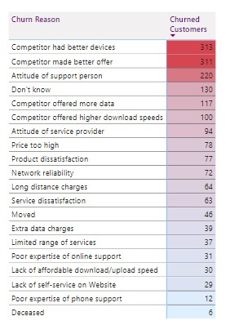
REASONS OF CHURNED

Slide 6
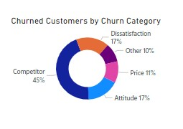

Slide 7
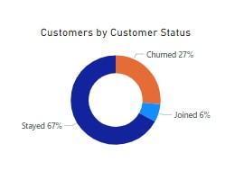

Slide 8
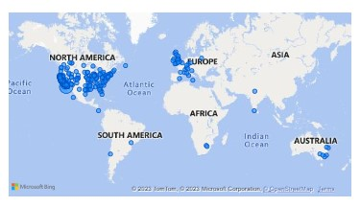
CHURNED BY CITY

Slide 9
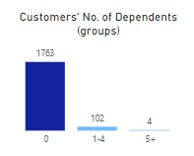

Slide 10
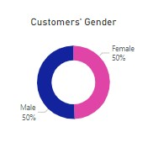

Slide 11
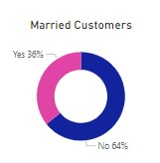
CHURNED CUSTOMERS MARRIED OR NOT

Slide 12
FINDINGS
Majority of customers find quality issue thus choose competitor
We have to increase the number of our loyal customer
Churned customers are gender neutral and majorly non married
106 customers are joined last quarter which is 23% percentage of total joined customer(454)
Churned customers are majorly cities from north America and Europe

Slide 13
THANK YOU

